Slide 1


SAP UI5 & FIORI with OData TRAINING using BAS
Anubhav Oberoy
Day – 8

Slide 2

Agenda – Day 8
What is Controller?
Structure of controller
Creating our first controller
How UI5 framework works
Basics of controller
Basics of OOPS
Concept of Control Hierarchy
Basics of Control Hierarchy
XML View
Creating our first xml view

Slide 3

Basics of OOPS (Object Oriented Programing)
PASSENGER
+passport no +name +nationality
Walk(), talk(), print_boarding()
0..n
PLANE
+Airline +Width +Height
+fly(), +land(), #load()
ENGINE, WINGS
+capacity, +speed, +color
inheritance
PASSENGER PLANE
+no_of_seats
Load()
CARGO PLANE
+cargo_space
Load()
Association (relation between classes which are not of same group of family)
1. Aggregation – lose coupling, both objects can function independently, SHOULD have relation
2. Composition – tight coupling, both cannot function independently, MUST have relation

Slide 4


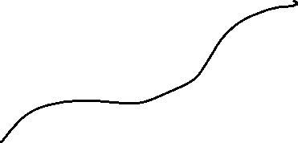






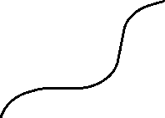
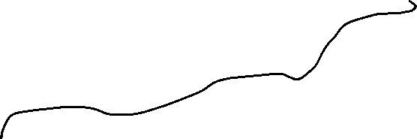



Concept of Control Hierarchy
Concept of control Hierarchy tells us about how the SAP UI5 Controls are structure on the basis of the object oriented Paradigm.
Note:- Whenever we see a control, and if we are unable to find a property, association, event or function in that class, check its parent class.
SimpleForm
content
sap.ui.base.ManagedObject
sap.ui.core.Element
sap.ui.core.Control
sap.m.Button
sap.m.InputBase
sap.ui.view
sap.m.Table
sap.ui.layout.form
sap.m.Input
sap.m.Column
SimpleForm
Some Frequently used Controls

Slide 5
MVC Architecture
MVC Stands for Model , View and Controller.
MVC is a design pattern used in software industries to build applications.
1. Model: It holds the data of the application inside itself.
2. View: It is the output and input interface of the application or can say it is the user interface .
3. Controller : It has all the processing logic inside itself (all written in JavaScript).
The Controller has a event handler to handle the triggered event
eventHandler()
Controller
[Processing]
All processing logic is written in JavaScript because browser only understand JavaScript.
Model will notify the controller back again with the data.
If the event need the data it request the model for the data
The View Triggers a event to the controller.
<<Event>>
The controller get the data and notifies the view back
If we want direct interaction between view and model we use data binding
Model
[Data]
View
I/O
Data Binding
User

Slide 6





What is a Controller?
In SAPUI5 except the view, all the JS files will follow a special syntax to create a class (module). As we all know that in software development, the entire solution is designed by creating multiple classes, these classes work together to run our solution. We have dependencies between our class. The syntax which we use is responsible for loading our dependent classes.
A controller is also a class, but since its special (controller) class, we also need to inherit a special SAPUI5 class to mark it as controller. The name of special class is sap/ui/core/mvc/Controller.
In JS we use extend keyword to perform inheritance.
A module name is derived from a class name in SDK by replacing every dot (.) with slash (/)
This syntax will load all the dependent classes asynchronously, this is why the syntax is called AMD like syntax (Asynchronous module loading). Also called scaffolding template.
Skeleton of any JS file in SAP UI5 – Considered as a class
sap.ui.define([“dependencies”, “dep2”, “dep3”],
function(oD1, oD2, oD3) {
--logic—
}
);
The Syntax of the controller has the AMD(Asynchronous Module Loading) like structure . This is also Know as Scaffolding Template
Modules

Slide 7
Structure of Controller
We define a simple controller as follows:
sap.ui.define([ "sap/ui/core/mvc/Controller" ],
function(Controller) {
"use strict";
return Controller.extend(“Address of Controller", {
// controller logic goes here
});
});

Slide 8
Rules of the Game
A library name always starts with small letter and a Class name always starts with capital letter. Both will follow the camel case.
Enumerators are constant values, example for type of button we use enum ButtonType
For a control we have properties, aggregation, events, function name, they always follow camel case
A controller contains methods that defines how models and views interact.
Whenever we see a property for a control, we will always have setter and getter methods to manipulate and read the property value. E.g. an Input control has value property, we will have setValue and getValue method for the same.
In order to work with a control inside the controller, we need to obtain object of that control. To obtain the control object we must not use the document.getElementById because it will give the object of HTML control not the object of UI5 control.
To obtain UI5 element object, we need to first get View Object,
We will obtain the view object inside the controller using this.getView()
‘this’ is the object of my current class, so inside controller it will point to current class
We can now obtain the object of the control using this.getView().byId(controlId)
For every event in UI5, we have attachEvent, detachEvent, fireEvent methods as well, which can be used to link, delink and trigger event programmatically.

Slide 9
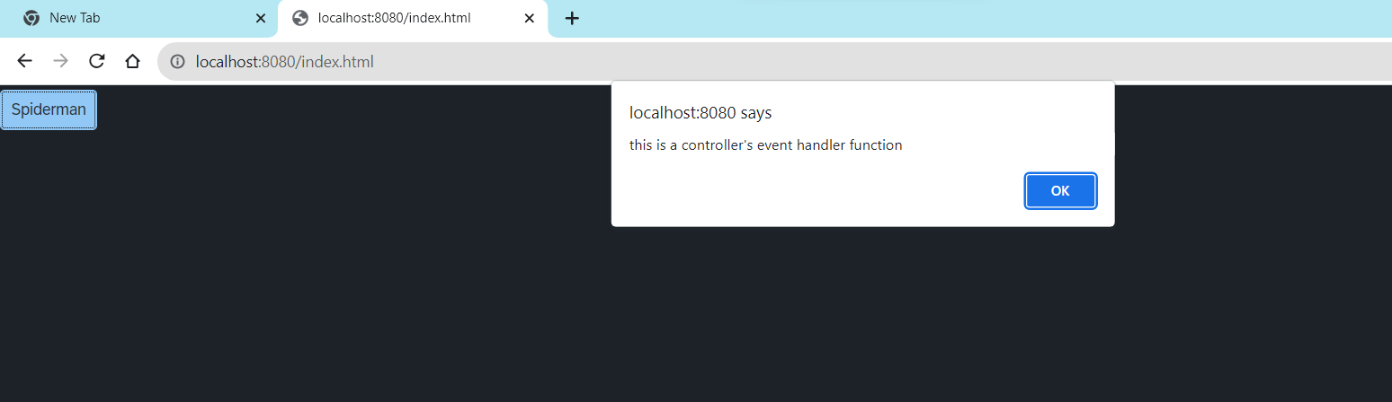
Hands – on: Create First Controller
Now to make our button work, we have to add some control logic to it, that logic will be written in the controller.
To add a controller to the project make a controller folder in the webapp directory and in that add a file named Main.controller.js.
In that file add the basic controller code in it and a function to show a alert message on click of the button.
Code Link:-
Main.view.js
Main.controller.js

Slide 10


How UI5 Framework works
Browser
CDN
SAP UI5 Framework
View
(Main.view.js)
controllerName=“…”
Call the controller Name
1
Index.html
3
The framework starts to find the controller with the same name
It will return controller name to the framework
var oView = new sap.ui.view({
viewName: “donald.view.Main",
type: “JS“
});
2
Loads the view
The object of the controller get all the controls .
6
8
Renderer
7
The view returns all the controls to the renderer
Controller
(Main.controller.js)
onInit() function
The renderer converts it into browser friendly language
Create the controller object
HTML + CSS
4
Call the constructor of controller
Get the object of the controller
5

Slide 11
XML View
What is XML?
XML stands for eXtensible Markup Language, it was originally developed to move data from one to another technology. It became popular to communicate between heterogeneous technologies.
XML is a tree data structure. Unlike HTML, we can use custom tags. Every programming language must support XML.
Portal
Java
App
ABAP
If_ixml
xml
xml
Data Objects → XML – Rendering
XML → Data Object – Parsing
Why XML View is better than other Views?
It is industry Standard.
XML handles the control id properly
XML rendering is faster
XML properly follows the MVC
Architecture.

Slide 12
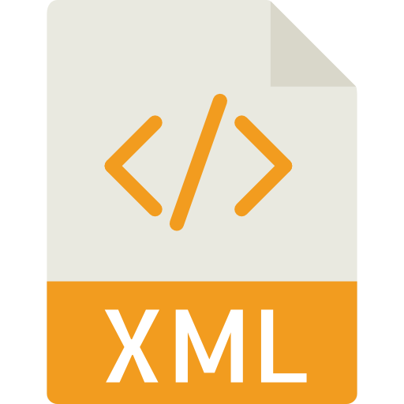
Structure of XML
<data>
<empStr>
<empId>5000</empId>
<empName>Jack</empName>
<salary>9500</salary>
<currency>EUR</currency>
</empStr>
<empTab>
<row>
….
</row>
</empTab>
</data>
Root Element
Child Element of <data> tag
Child Element of <empStr> tag
Skeleton of XML View
<mvc:View xmlns:mvc=“sap.ui.core.mvc” xmlns=“sap.m” controllerName=“pathOfContro.”>
<Button text=“Click Me”></Button>
</mvc:View>

Slide 13

End of Day 8

Slide 14

Questions

Slide 15

Sakshi Gupta

Slide 16


We’re committed to empower you to be
Most Desirable Resource
through powerful training solutions.
We build the workforce of the future.
250+
Corporate Clients
30,000+
Learners Trained
25000+
Learners Placed
FREE WEBINARS
Sign up for free webinars with industry experts every fortnight!
Enroll Now!
Contact us today!
https://anubhavtrainings.com/

Slide 17
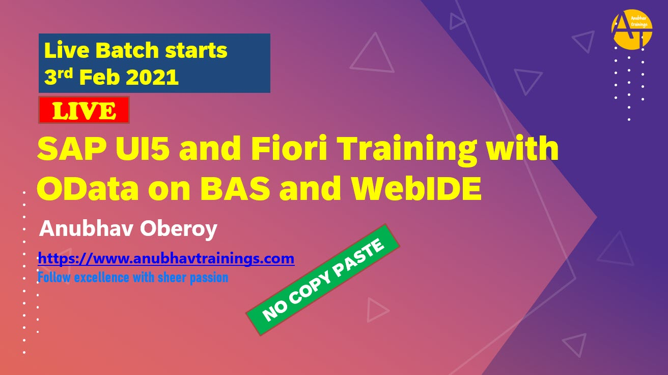
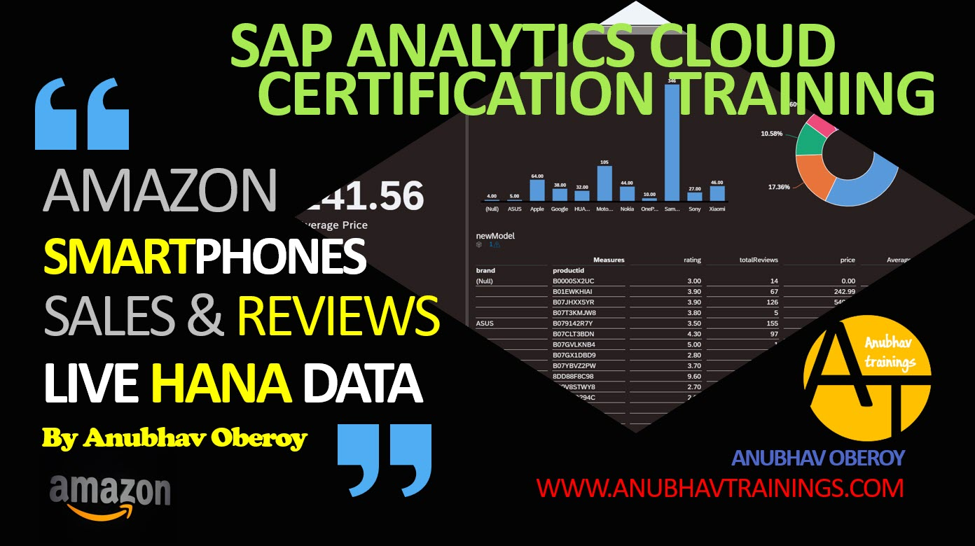

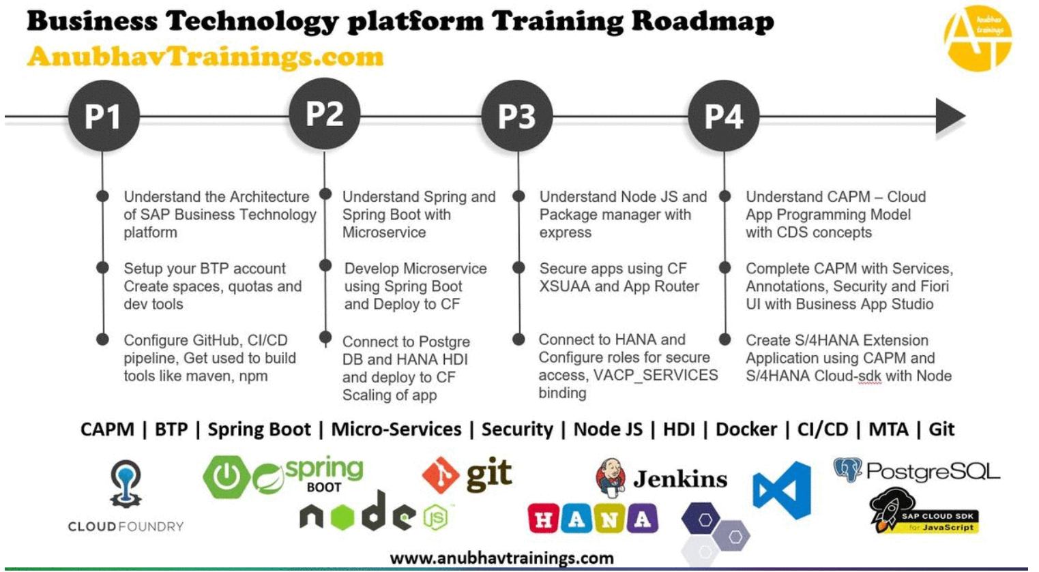
More from AnubhavTrainings.com

Slide 18
Title
Content

